Slide 1
OBJECT ORIENTED
PROGRAMMING
Spring 2024
Miss Ayesha Majid

Slide 2
Who am I?
Instructor: Ayesha Majid
Email: ayesha.majid@riphah.edu.pk
Office Hours:
Day | Time
Monday | 9:30 am – 1:00 pm
Tuesday | 9:30 am – 1:00 pm
Wednesday | 11:30 am – 1:00 pm
Thursday | 12:00 pm – 1:00 pm
Friday | 11:00 am – 1:00 pm

Slide 3
Course Pre-requisites
Undergrads must have passed Programming fundamentals.
All students must possess strong programming skills

Slide 4
Course Objectives:
This course provides an introduction to object-oriented programming (OOP) using the Java programming language. Its main objective is to teach the basic concepts and techniques which form the object-oriented programming paradigm

Slide 5
Lecture Schedule:
As per the timetable.
Makeups will be announced.

Slide 6
Communication
• LMS
Announcements
Exams
Quizzes
• Slack
Announcements
Detailed discussions
Q/A
• Email
Instructor

Slide 7
Evaluations:
Assessments | Weightage
Mid (S1 and S2) | 15%
Final | 30%
Quiz | 10%
Assignments | 10%
Lab | 15%
Project | 20%

Slide 8
Mid Exams
There could be a single mid.
Or there could be two sessional named as S1and S2 and both will carry equal weightages.

Slide 9
Quizzes
There will be both announced and unannounced quizzes carrying equal weights.
Best 4 quizzes will be counted towards the final grade it depends upon the number of quizzes taken throughout semester. That means you need to perform well in at least 4 quizzes.

Slide 10
Assignments
There will be 4 or could be more coding intensive assignments throughout the semester.

Slide 11
Lab
There will be both in lab and out of lab tasks. Lab tasks will be checked within lab and no later than the following lab. For example, you can get your lab 1 task checked no later than your lab 2 and vice versa.

Slide 12
Project
There will be a semester project so start working on your ideas.
Two/Three group members per project.

Slide 13
Cheating and Plagiarism
All work MUST be done independently
What is cheating?
Sharing code: by copying, retyping, looking at, or supplying a file
Describing: verbal description of code from one person to another.
Coaching: helping your friend to write a lab, line by line
Searching the Web for solutions
Copying code from a previous course or online solution
You are only allowed to use code we supply
I will be running plagiarism detection tools
What is NOT cheating?
Explaining how to use systems or tools
Helping others with high-level design issues

Slide 14


Slide 15
COURSE INTRO
• You know most of the stuff
• Discipline and Respect
• Course Policies
• Attendance
• Originality of work
• Timely submission
• Etc etc. etc.

Slide 16
COURSE POLICIES
• Attendance as per the university requirement
• Attendance will be marked at any point during the class session, and you
need to be present to get yourself marked as that
• A zero tolerance will be shown against the use of unfair means for your
assessments
• If you miss your assessment or assignment, you miss it, no makeups will be
done
• All academic material will be provided on the moellim page and you will be responsible to access it from there

Slide 17
COURSE CONDUCT
• There will be a 3 +1 sessions each week.
• We will spend some time in learning the concepts but majority of the time building code to implement those concepts.
• Being able to write code independently is the main goal
• You will be provided code samples done in each lessons but will be required to build similar codes yourself later at home at your own page
• You are encouraged to bring your devices so you may practice code during the session as it will be taught

Slide 18
Tool/ Software to be used

Slide 19

Eclipse

Slide 20
Why eclipse.
Eclipse has lots of cool features and it makes Development with spring framework seamless. It also supports Java/J2EE development and has built in plugins for most frameworks. It has cool integration with git and makes the code check in process simpler. Debugging is great too.

Slide 21
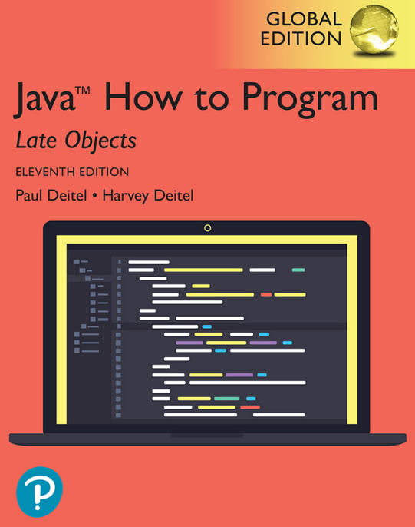
Reference book:

Slide 22
OBJECT ORIENTED PROGRAMMING
LET'S DIVE IN..........

Slide 23
FEAR OF PROGRAMMING IS
REAL !!!!

Slide 24
Java - What is OOP?
OOP stands for Object-Oriented Programming.
Procedural programming is about writing procedures or methods that perform operations on the data, while object-oriented programming is about creating objects that contain both data and methods.
Object-oriented programming has several advantages over procedural programming:
OOP is faster and easier to execute
OOP provides a clear structure for the programs
OOP helps to keep the Java code DRY "Don't Repeat Yourself", and makes the code easier to maintain, modify and debug
OOP makes it possible to create full reusable applications with less code and shorter development time
Tip: The "Don't Repeat Yourself" (DRY) principle is about reducing the repetition of code. You should extract out the codes that are common for the application and place them at a single place and reuse them instead of repeating it.

Slide 25
Uses of Java
You can use Java to develop:
Desktop applications
Web applications
Mobile applications (especially Android apps)
Web and application servers
Big data processing
Embedded systems
and much more.

Slide 26
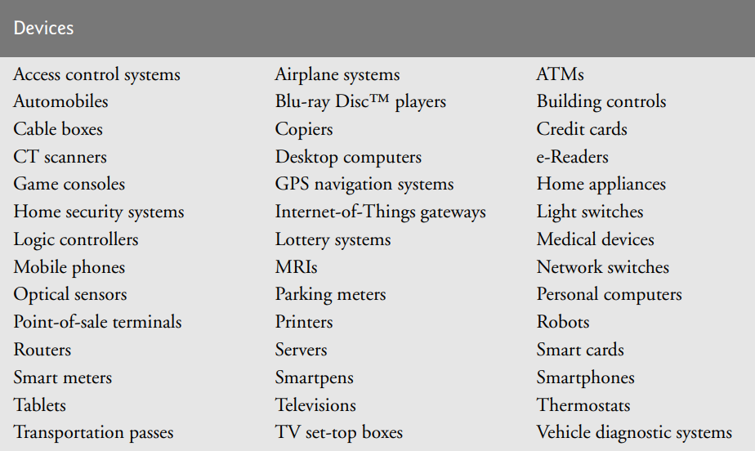
Some devices that use Java

Slide 27
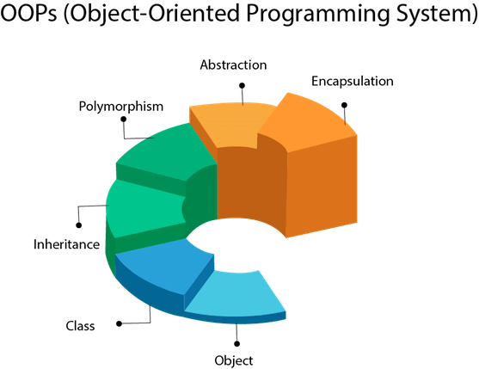
Features of OOP

Slide 28
Object Oriented Programming
Programming that is based on the Objects and Interactions
Object….. What is it???
Thing…. Entity…
Dictionary definition a material thing that can be seen and touched.
In OOP
An object in OOP is nothing but a self-contained component which consists of methods and properties to make a particular type of data useful
A datatype Many different ways to define an object

Slide 29
Object Oriented Programming
Everything is an object. A program is a bunch of objects telling each other what to do, by sending messages. Each object has its own memory and is made up of other objects. Every object has a type (class). All objects of the same type can receive the same messages.

Slide 30
The Real World Around us
Physical World entities like rooms, people, chairs, windows, fans etc. Focus on real objects to be mapped in computer program
Objects has Attributes – characteristics/properties
For people; name, dob, height, weight, eye color, job title
For cars; model, engine number, no of door, engine capacity etc.
Behavior: The actions that an object performs; A student attends classes, A car moves, A window opens/closes etc. Actions are usually triggered by some external force/entity

Slide 31
Object Oriented Programming
An object is anything that can be represented by data in a computer’s memory and manipulated by a computer program.
It can be a real-world tangible object or an abstract idea e.g. Car, Country, Animal, match, fear, cold, tv, cup, food, hunger etc.,

Slide 32
Objects
They have:
Data type and Value
Behavior: Methods/functions Operates on the data/properties of the object Objects show behavior when a method is called by another object Provide services to the environment/other objects Method calls

Slide 33
Classes – to Declare Objects
Classes are the programming construct that declare the attributes and behavior of a set of objects
Classes are the templates to create objects
An instance of a class is called an object

Slide 34
Example of Object
Problem: Design and build a computer hockey game
Object: Hockey player
Characteristics: Position, height, weight, salary, number of goals.
Responsibilities: Pass the puck, shoot, skate forward, skate backward, punch another player, etc.

Slide 35
Class Activity:
Problem Computation modeling in biology
Write a program that simulates the growth of virus population in humans over time. Each virus cell reproduces itself at some time interval. Patients may undergo drug treatment to inhibit the reproduction process and clear the virus cells from their body. However, some of the cells are resistant to drugs and may survive.
What are objects ? Characteristics ? Responsibilities ?

Slide 36
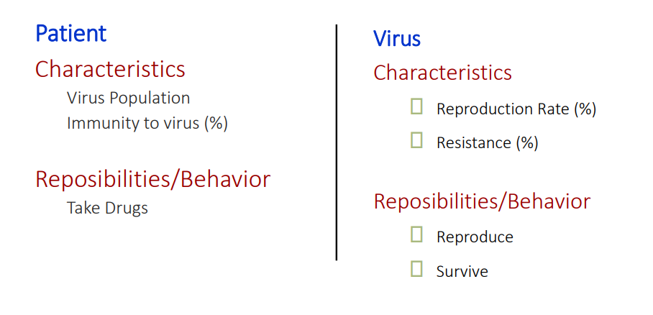
Solution

Slide 37
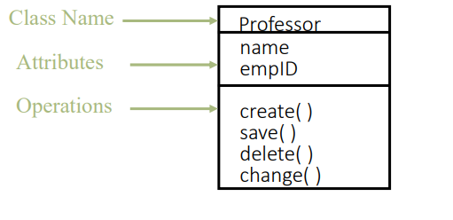
Class Representation in UML
A class is represented by a compartmented rectangle
A class is comprised of three sections
The first section contains the class name
The second section shows the structure (attributes)
The third section shows the behavior (operations)

Slide 38
Object-Oriented Programming
Instances of a class are called objects
The act of creating a new instance of an object is called instantiation.
Each object of a class have the same attributes and behavior but its own state Values of the attributes

Slide 39
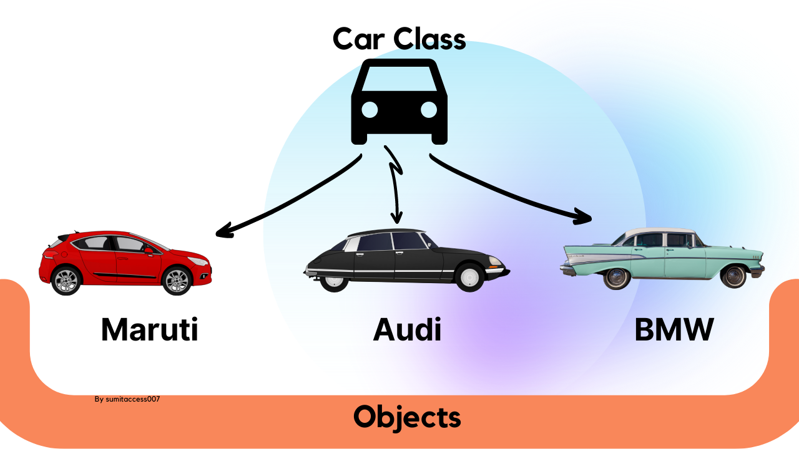

Slide 40
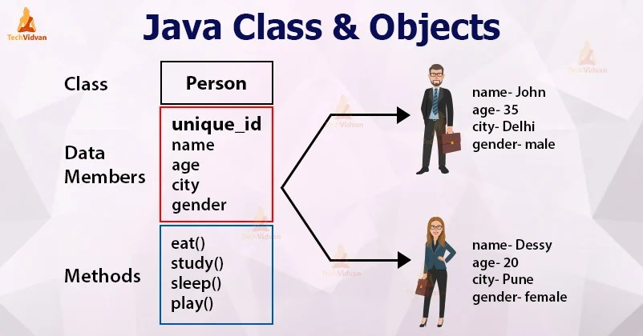

Slide 41
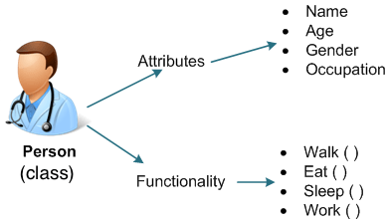

Slide 42
Identifying Classes/Objects
Classes are identified by identifying nouns and noun phrases in problem statement

Slide 43
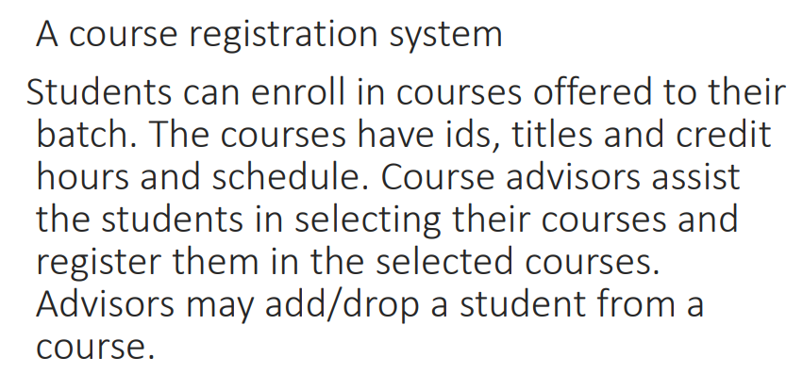
Activity 1: Identifying classes and objects:

Slide 44
Activity 2: Identify Classes and Objects.
Design a library catalog system. The system must support the registration of customers, adding and removing books, checking books in and out, satisfying queries regarding the availability of books.

Slide 45
Activity 3: Identify Classes
I went with Bilal to the university
Farhan opened the letter and read the message.
Ali is leaving Islamabad on the eight o’clock flight to Toronto.
Have you seen my hockey stick anywhere in the basement?
In my determination to succeed, I spent long hours studying in the library.
Notes:
Flight number
Flight name
Flight departure
Flight Arrival
Flight Destination
Flight source

Slide 46
Activity 4: Identify Objects and their attributes and behavior
An employee belongs to a department. Each employee has an id, name salary scale and minimum number of working hours. The departments have names, locations, managers, and total number of employees working in them. Each department is assigned projects which have an id, start and end date and number of people working on them. The departments have to present a report at the end of each project showing the total cost and schedule of the project.

Slide 47
Characteristics of OOP
Everything is an object ! Computation is performed by objects communicating with each other.
Objects communicate by sending and receiving messages
Each object has its own memory, which consists of other objects
Every object is an instance of a class (has a type)
The class is the repository for behavior associated with an object
All objects of the same type can perform the same actions i.e., They can receive the same message

Slide 48
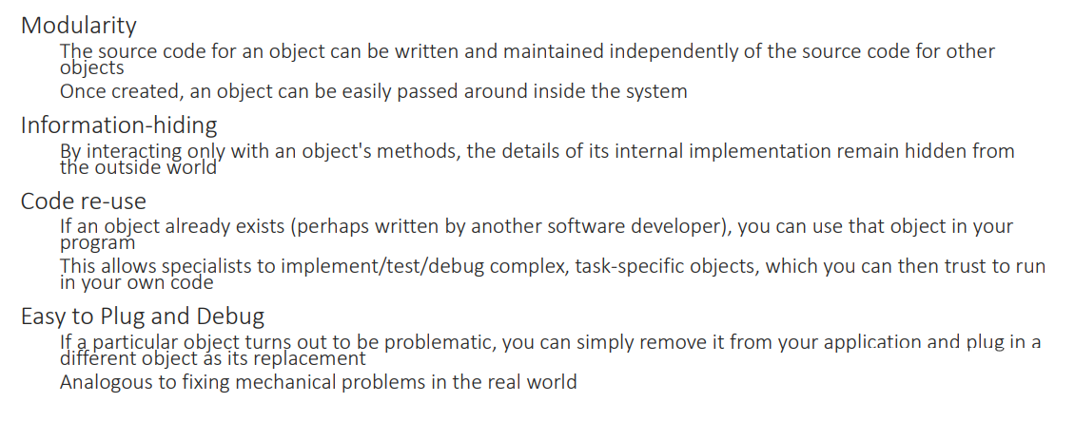
Advantages of Using Objects

Slide 49
What is Java?

Slide 50
What is Java?
Java is a popular programming language, created in 1995.
It is owned by Oracle, and more than 3 billion devices run Java.
It is used for:
Mobile applications (especially Android apps)
Desktop applications
Web applications
Web servers and application servers
Games
Database connection
And much, much more!

Slide 51
Why Use Java?
Java works on different platforms (Windows, Mac, Linux, Raspberry Pi, etc.)
It is one of the most popular programming languages in the world
It has a large demand in the current job market
It is easy to learn and simple to use
It is open-source and free
It is secure, fast and powerful
It has huge community support (tens of millions of developers)
Java is an object oriented language which gives a clear structure to programs and allows code to be reused, lowering development costs
As Java is close to C++ and C#, it makes it easy for programmers to switch to Java or vice versa

Slide 52
Java QuickStart
In Java, every application begins with a class name, and that class must match the filename.
Let's create our first Java file, called Main.java, which can be done in any text editor (like Notepad).
The file should contain a "Hello World" message, which is written with the following code:

Slide 53
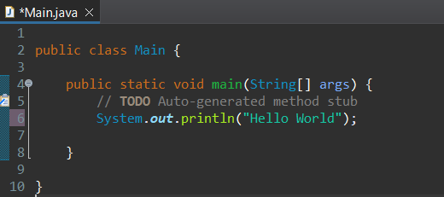
Example:

Slide 54
Class Activity 1
Write down the above basic Java code for printing hello world 10 times.

Slide 55
Working
Working of the "Hello World" program shown above :
public class Main :
  In Java, every program must contain a class.
  The filename and name of the class should be the same.
  Here, we've created a class named "Main".
  It is the entry point to the application.
public static void main(String[]args){..} :
  This is the main() method of our Java program.
  Every Java program must contain the main() method.
System.out.println("Hello World"):
  The above code is used to display the output on the screen.
  Anything passed inside the inverted commas is printed on the screen as plain text.

Slide 56

The main Method
The main() method is required, and you will see it in every Java program:
Any code inside the main() method will be executed. Don't worry about the keywords before and after main. You will get to know them bit by bit while reading this tutorial.
Its syntax is always public static void main(String[] args). The only thing that can be changed is the name of the string array argument. For example, you can change args to myStringArgs.
For now, just remember that every Java program has a class name which must match the filename, and that every program must contain the main() method.
System.out.println()
Inside the main() method, we can use the println() method to print a line of text to the screen:

Slide 57
Notes:
Note: The curly braces {} marks the beginning and the end of a block of code.
System is a built-in Java class that contains useful members, such as out, which is short for "output". The println() method, short for "print line", is used to print a value to the screen (or a file).
Don't worry too much about System, out and println(). Just know that you need them together to print stuff to the screen.
You should also note that each code statement must end with a semicolon (;).

Slide 58
Example Explained:
Every line of code that runs in Java must be inside a class. In our example, we named the class Main. A class should always start with an uppercase first letter.
Note: Java is case-sensitive: "MyClass" and "myclass" has different meaning.
The name of the java file must match the class name. When saving the file, save it using the class name and add ".java" to the end of the filename.

Slide 59
Java is case-sensitive
You may also note that Java is case-sensitive. This means that Java has the ability to distinguish between upper- and lower-case letters. For example, the variable “myClass” and the variable “myclass” are two totally different things.

Slide 60
Naming Conventions
For classes, we use Pascal Convention. The first and Subsequent characters from a word are capital letters (uppercase).
Example: Main, MyScanner, MyEmployee, CodeWithHarry
For functions and variables, we use camelCaseConvention. Here the first character is lowercase, and the subsequent characters are uppercase like myScanner, myMarks, CodeWithHarry

Slide 61
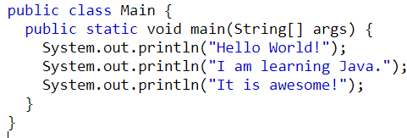
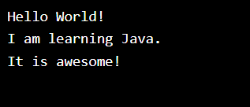
Java Output / Print
You learned from the previous slides that you can use the println() method to output values or print text in Java
You can add as many println() methods as you want. Note that it will add a new line for each method:

Slide 62
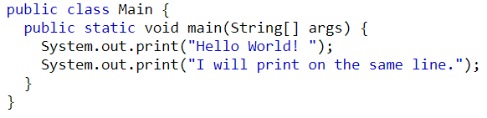

The Print() Method
There is also a print() method, which is similar to println().
The only difference is that it does not insert a new line at the end of the output:

Slide 63
Variables and Data Types in Java Programming
Just like we have some rules that we follow to speak English (the grammar), we have some rules to follow while writing a Java program. This set of these rules is called syntax. It’s like Vocabulary and Grammar of Java.
Variables
A variable is a container that stores a value.
This value can be changed during the execution of the program.
Example: int number = 8; (Here, int is a data type, the number is the variable name, and 8 is the value it contains/stores).

Slide 64
Rules for declaring a variable name
We can choose a name while declaring a Java variable if the following rules are followed:
Must not begin with a digit. (E.g., 1arry is an invalid variable)
Name is case sensitive. (Harry and harry are different)
Should not be a keyword (like Void).
White space is not allowed. (int Code With Harry is invalid)
Can contain alphabets, $character, _character, and digits if the other conditions are met.

Slide 65
Data Types
Data types in Java fall under the following categories
Primitive Data Types (Intrinsic)
Non-Primitive Data Types (Derived

Slide 66
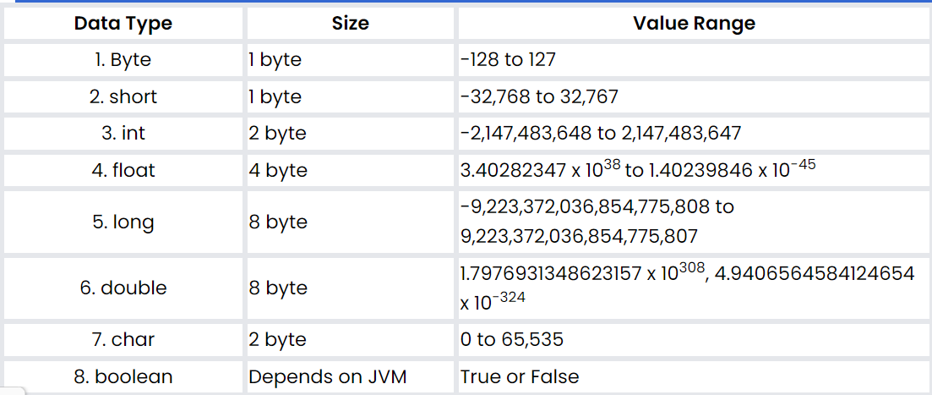
Primitive Data Type:
Java is statically typed, i.e., variables must be declared before use. Java supports 8 primitive data types:

Slide 67
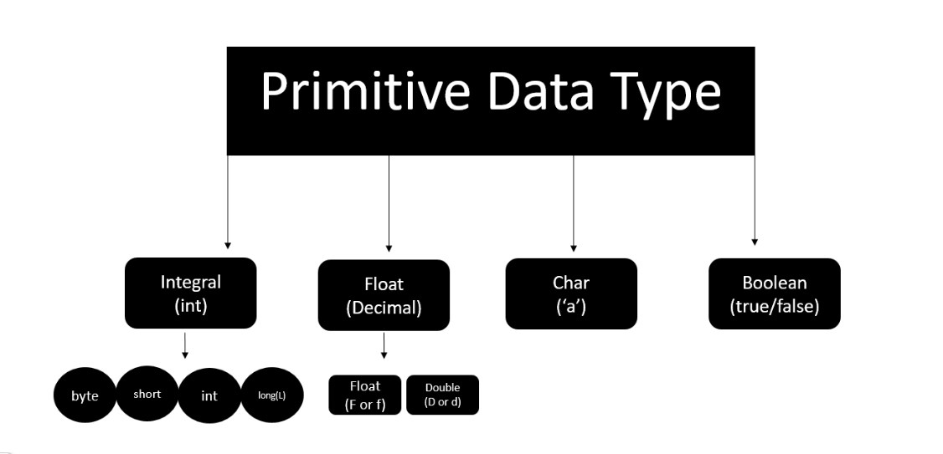

Slide 68
Literals in Java
A constant value that can be assigned to the variable is called a literal.
101 – Integer literal
10.1f – float literal
10.1 – double literal (default type for decimals)
‘A’ – character literal
true – Boolean literal
“Harry” – String literal

Slide 69
Keywords
Words that are reserved and used by the Java compiler. They cannot be used as an Identifier.
{You can visit docs.oracle.com for a comprehensive list}

Slide 70
Getting User Input in Java
Reading data from the Keyboard :
Scanner class of java.util package is used to take input from the user's keyboard.The Scanner class has many methods for taking input from the user depending upon the type of input. To use any of the methods of the Scanner class, first, we need to create an object of the Scanner class as shown in the below example
import java.util.Scanner; // Importing the Scanner classScanner sc = new Scanner(System.in); //Creating an object named "sc" of the Scanner class.
Taking an integer input from the keyboard :
Scanner S = new Scanner(System.in); //(Read from the keyboard)
int a = S.nextInt(); //(Method to read from the keyboard)

Slide 71
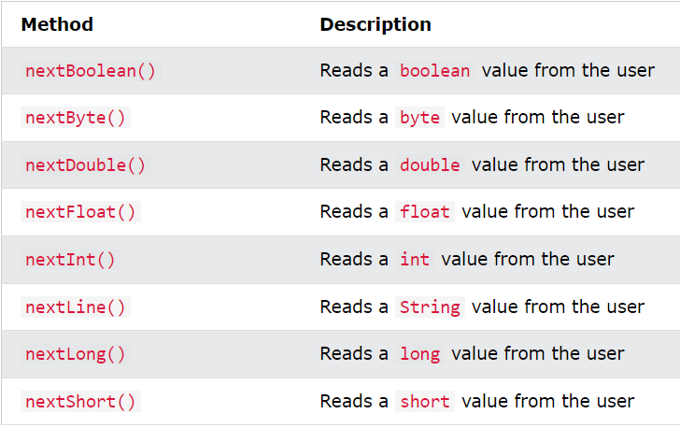
Input Types

Slide 72
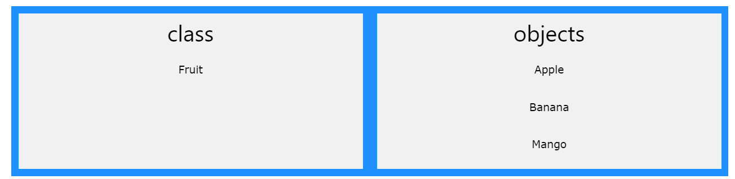
Java - What are Classes and Objects?
Classes and objects are the two main aspects of object-oriented programming.
Look at the following illustration to see the difference between class and objects:

Slide 73
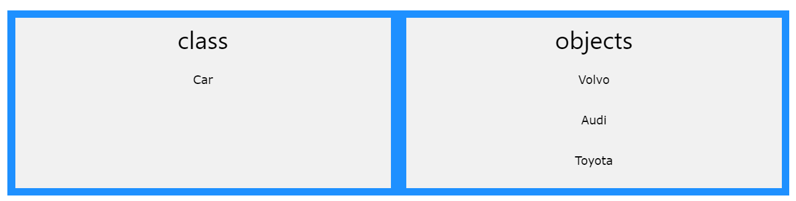
Java - What are Classes and Objects?
Another example
So, a class is a template for objects, and an object is an instance of a class.
When the individual objects are created, they inherit all the variables and methods from the class.

Slide 74
References
https://www.w3schools.com/java/
https://www.freecodecamp.org/news/object-oriented-programming-concepts-java/

